Slide 1





CAAI PROJECT
Customer Value Optimization Report

Slide 2







MEET THE TEAM
Gunjan Kapoor
EMBADTA 24003
Akriti Sharma
EMBADTA 24014
By Group 3
Akanksha Singh
EMBADTA 24006
Abhishek Mishra
EMBADTA 24016

Slide 3


PROJECT CONTEXT
Overview of Business Challenges and Objectives
Business Facing Challenges:
Gradual decline in sales performance
Decreasing customer retention rates
Rising marketing and customer acquisition costs
Primary Objective: Enhance sales by capitalizing on the existing customer base through personalized marketing, loyalty programs, and excellent customer service.
Proposed Action plan:
Analysis of Historic Data (10 years) to assess:
Customer loyalty trends
Segmentation based on platform affiliation and purchase behavior
Identifying at-risk customers through churn analysis
Focus on actionable insights to improve customer retention and acquisition strategies

Slide 4

Data Dictionary
Product Master data set | Product Master data set | Product Master data set | Product Master data set | Product Master data set
Name | Description | Primary KEY | Data Type | Length
product_id | Product ID | Y | character | 25
product_name | Product Name |  | character | 25
product_category | Product category |  | character | 25
category | Business |  | character | 15
Key Datasets for Analysis
Retailer Master data set | Retailer Master data set | Retailer Master data set | Retailer Master data set | Retailer Master data set
Name | Description | Primary KEY | Data Type | Length
grower_house_ain | Retailer ID | Y | character | 25
first_name | Retailer first name |  | character | 25
last_name | Retailer Last Name |  | character | 25
city | Retailer City |  | character | 20
country | Retailer Country |  | character | 20
phone | Retailer Phone Number |  | Numeric | 15
email | Retailer Email ID |  | character | 50
Sales data | Sales data | Sales data | Sales data | Sales data
Name | Description | Primary KEY | Data Type | Length
unique_id | Sales Order No. | Y | character | 25
grower_house_ain | Retailer ID |  | character | 25
category | Business |  | character | 15
product_name | Product Name |  | character | 25
converted_msrp | Total Amount |  | Numeric | 20
converted_acres | Acres |  | Numeric | 20
converted_qty | Quantity of the Product Sold |  | Numeric | 20
crop_year | Crop year |  | Numeric | 5

Slide 5
Data Merging
From raw to refined
Step 1:
Merges the retailer_ data with the sales_ data using the grower_house_ain column as the key. Then selects specific columns from both data frames:
From Retailer : grower_house_ain, first_name, last_name, city, country.
From sales: unique_id, grower_house_ain, category, product_name, converted_msrp, converted_acres, converted_qty, crop_year.
Sales1 data is created
Step 2:
Merges the product_data with the above data using product_name as the key.
From product: product_id, product_name, product_category, category.
From sales1: Various fields including unique_id, grower_house_ain, product_name, and others.
Sales2 data is created

Slide 6
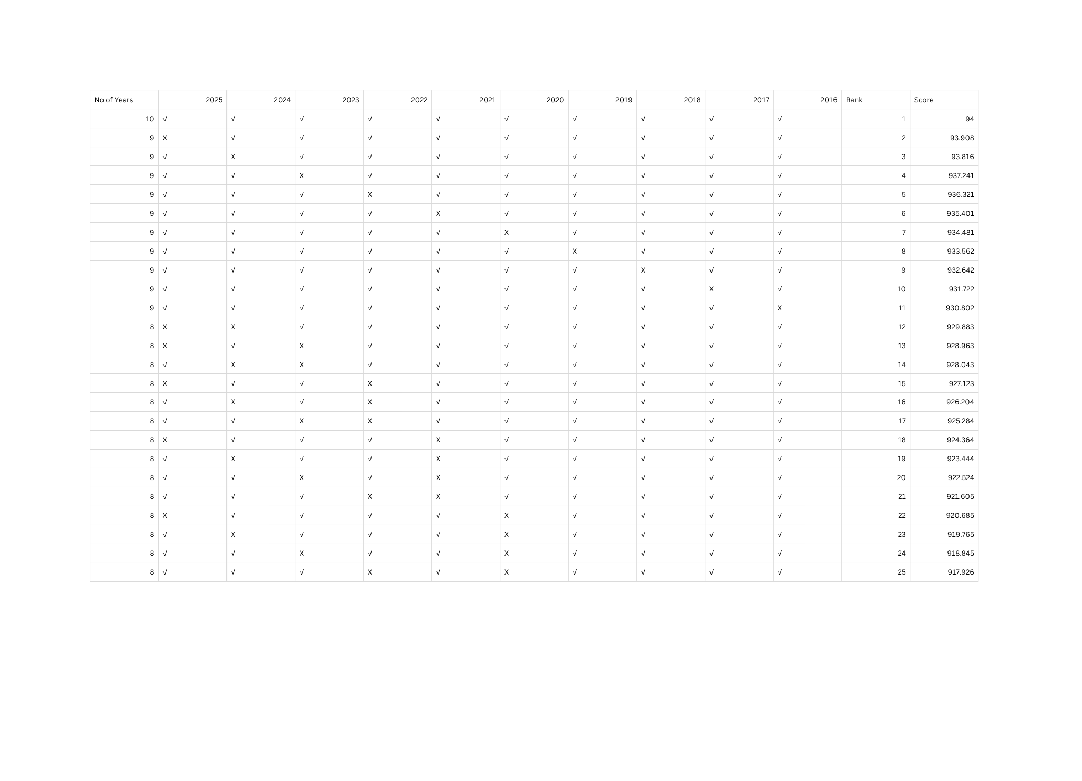
Data Ranking and Prioritization

Slide 7

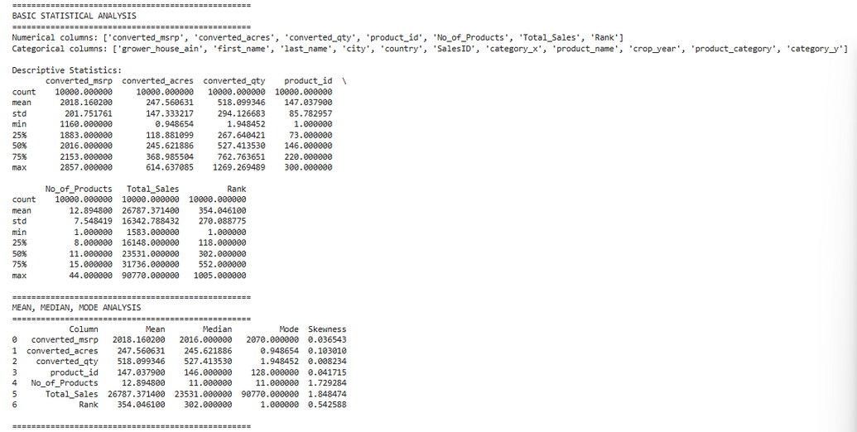
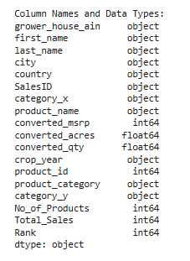
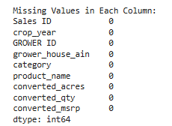
Exploratory Data Analysis
Mean, Median, Mode, Skewness and Feature selection
Statistics for three variables:
total_sales, product_count, and rank
The dataset consists of 10,000 grower records and 18 structured fields, analyzed to understand sales behavior, product spread, and performance ranking.
Focus was placed on three key numerical indicators — Total_Sales, No_of_Products, and Rank.
Key Findings:
Total_Sales shows an average of ₹26.8K with a median of ₹23.5K and a maximum of ₹90.7K.
The data is right-skewed (1.85), highlighting a small group of high performers driving overall revenue.
No_of_Products averages 13 per grower, ranging from 1 to 44, also right-skewed (1.73) — indicating that product diversity is concentrated among a few growers.
Rank has a mean of 354 and median of 302, with a mild left skew (0.54), suggesting a balanced distribution of mid and high performers.
Feature Selection:
Based on variability and business significance, Total_Sales, No_of_Products, and Rank were selected as the most representative features to study grower performance and operational diversity.

Slide 8
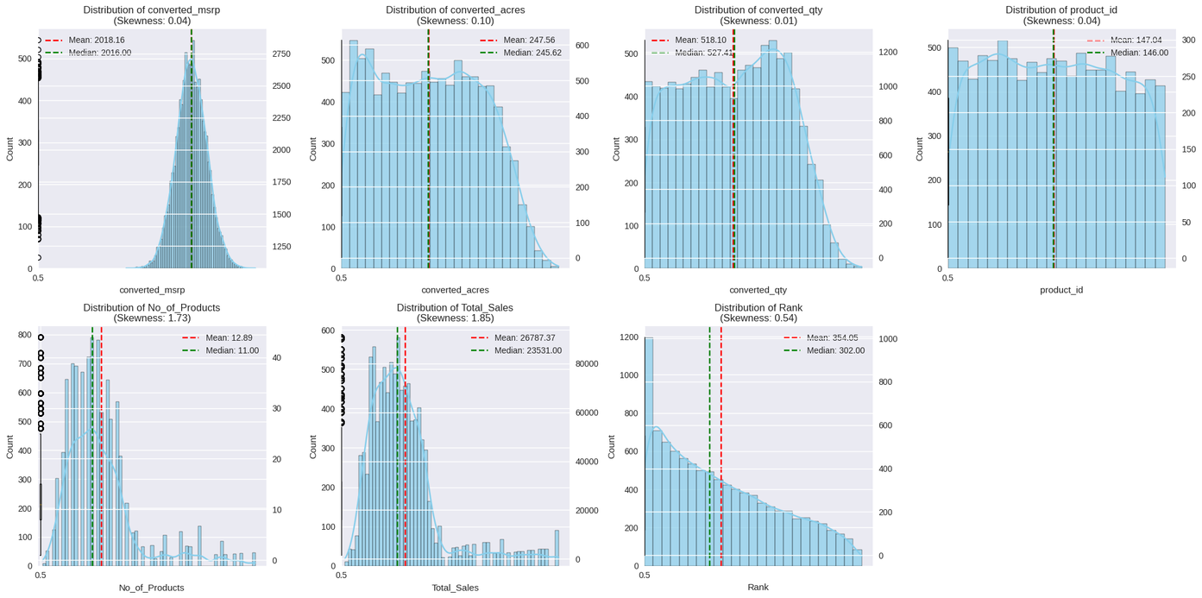
Variable Distribution Analysis
Converted MSRP (~2,018 avg) follows a near-normal distribution with minimal skewness (0.03), indicating uniform pricing.
Converted Acres (~247 acres avg) and Converted Quantity (~518 units avg) are slightly right-skewed, showing few large-scale transactions.
Product ID (1–300 range) is evenly distributed, confirming balanced product representation.
No. of Products (avg 13) and Rank (avg 354) are moderately skewed, with most entries concentrated at lower levels.
Total Sales (avg ₹26.8K, skew 1.85) shows a long right tail, driven by a few very high-value sales.

Slide 9
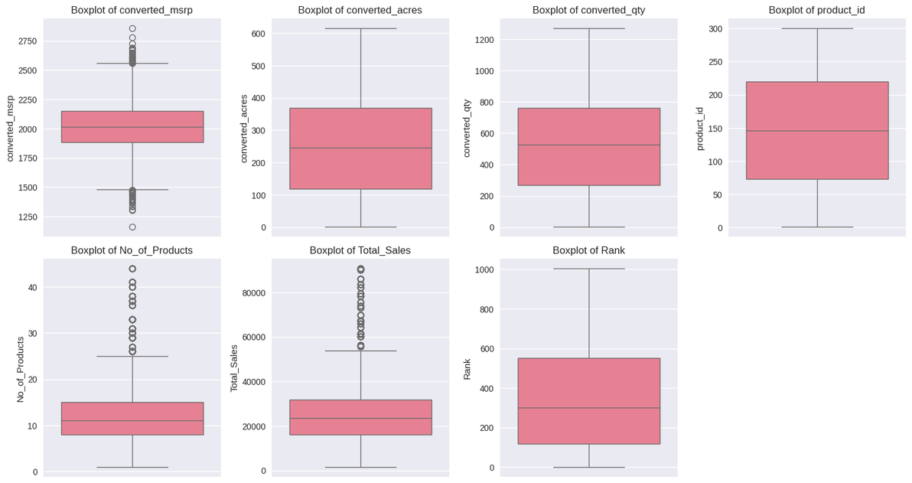
Data Refinement
Plotting and Handling Outliers
Average MSRP around 2,018 units, with consistent pricing between 1,883 – 2,153.
Median project size ~246 acres, ranging up to 615 acres — indicating diverse project scales.
Median quantity sold ~527 units, with some large-volume sales exceeding 1,200 units.
Average of ~13 products per record; some deals include up to 44 products — high product diversity.
Median total sales value ~23,500, with high variation up to 90,770.
Most ranks between 100–550 — concentration in mid-tier performing products

Slide 10
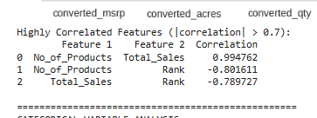
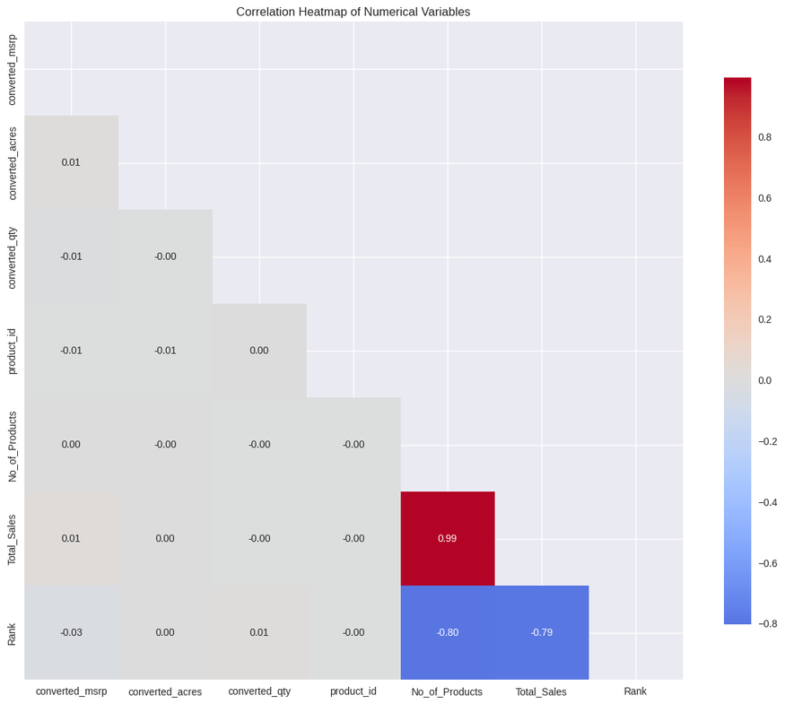
Correlation Analysis
Correlation Among Key Variables
No_of_Products and Total_Sales show a very strong positive correlation (0.99) — more products typically lead to higher total sales.
No_of_Products and Rank have a strong negative correlation (-0.80) — higher-ranked (better-performing) entries tend to have fewer products.
Rank and Total_Sales also show a strong negative correlation (-0.79) — as rank improves, total sales increase.
Overall, the dataset reveals clear relationships between sales volume, product diversity, and ranking performance.
The correlation heatmap confirms these strong linear associations, with distinct high-correlation clusters among product and sales metrics.

Slide 11
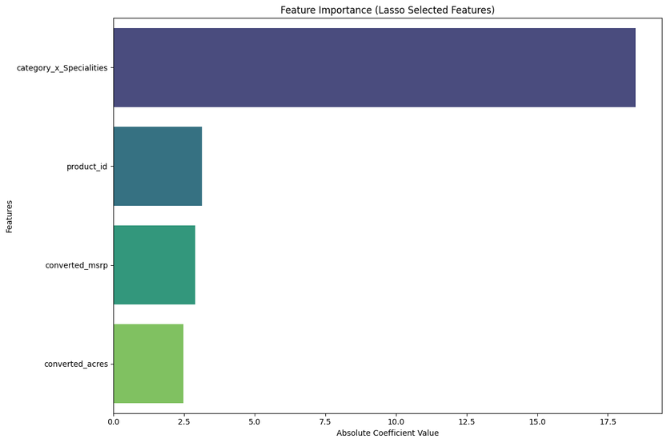
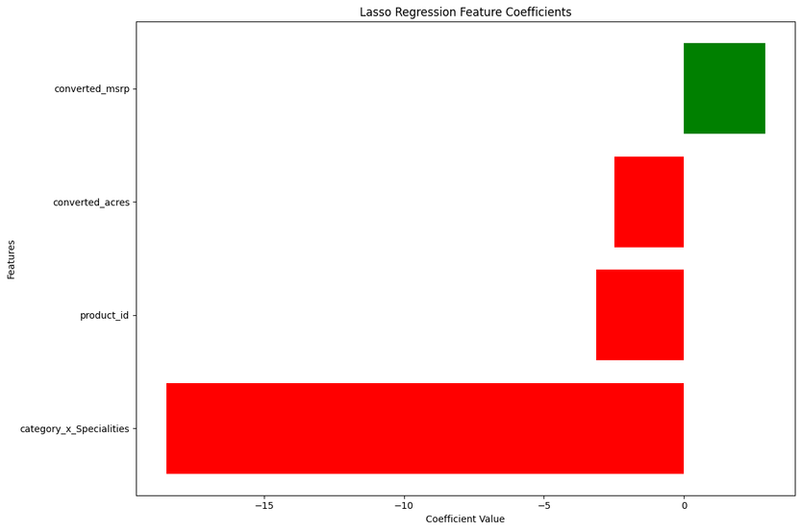
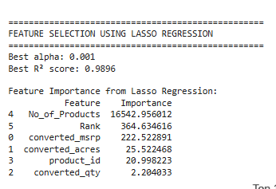
Exploratory Data Analysis
Feature selection Lasso Regression Method
Dominant Predictor: No_of_Products drives nearly all variation in Total_Sales; each additional product boosts sales by ~2180 units on average.
Model Accuracy: Achieved an R² ≈ 0.99, showing a strong fit with minimal unexplained variance.
Minor Predictors:
Converted_msrp and Rank have small positive effects (~+1 per unit) after accounting for No_of_Products.
Converted_acres, product_id, and converted_qty have negligible influence after penalization.
Multicollinearity: Strong negative correlation between No_of_Products and Rank (corr ≈ -0.80), indicating overlap in the information they provide.

Slide 12



Overview of Modeling Techniques
K-Means Clustering
Random Forest
Market Basket

Slide 13
Customer Clusters Nomenclature for Loyalty and Value Segmentation
CLUSTER 1
PROTECT+
Highest in loyalty​
Highest # products
Highest $MSRP
Protect this highest value customer, and add in missing product categories​
CLUSTER 2
NURTURE
High in loyalty​
Moderate # products
Moderate $MSRP
Nurture customer relationship. Grow number of products, add missing categories
​
CLUSTER 3
PROSPECT
Moderate in loyalty​
Low # products
Moderate $MSRP
Prioritize resources, fish for move up candidates to Nurture. When resources are scare focus on Nurture and Protect+
CLUSTER 4
IGNORE
Low in loyalty​
Low # products
Low $MSRP
Ignore the customers as they are low in Loyalty and products. Instead focus on Protect+, Nurture and Prospect

Slide 14

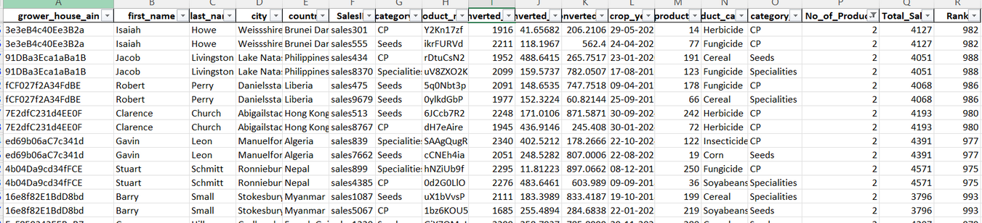
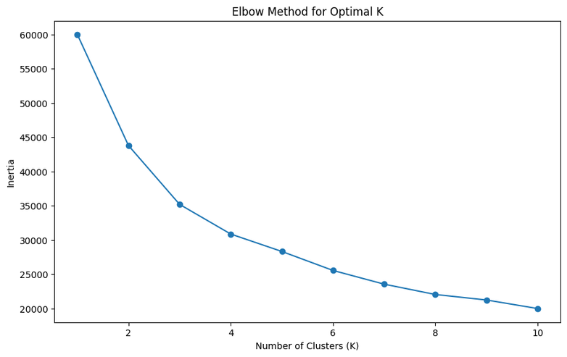
K-Means Clustering-Complete
The K-Means model will generate customer labels by analyzing underlying three features
Rank
Number of products.
Total sales
This helps identify distinct grower groups based on sales performance and engagement level, enabling targeted marketing and resource planning.
The Elbow Method shows that 4 clusters best fit the data, providing a balance between compactness and simplicity.
Beyond 4 clusters, the drop in WCSS is minimal, indicating limited improvement in clustering quality.

Slide 15
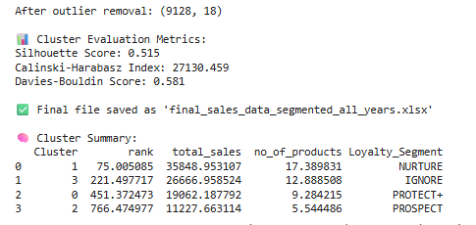
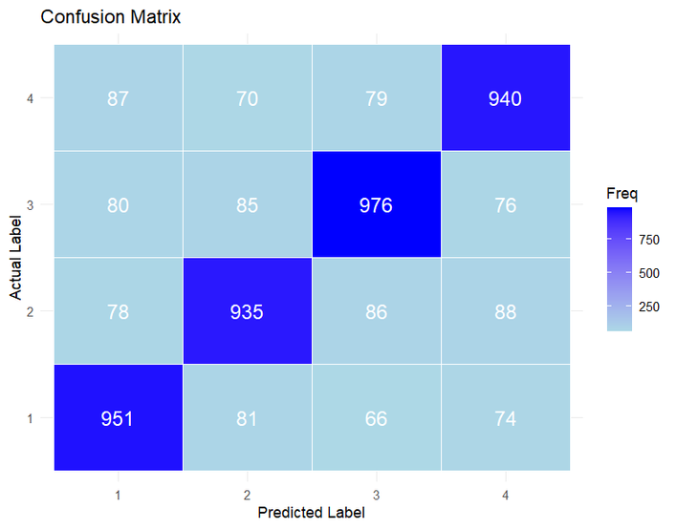
Evaluation of Clustering Model
K-Means Accuracy and Confusion Matrix
K-Means Accuracy Calculation:
Evaluates clustering quality using key performance metrics — Silhouette Score (0.515), Calinski-Harabasz Index (27189.489), and Davies-Bouldin Score (0.581).
These scores indicate moderate cluster separation and balanced cohesion across the four grower groups.
Accuracy is derived from the confusion matrix, measuring how well predicted cluster labels align with actual loyalty segments.
Confusion Matrix :
The Confusion Matrix visualizes clustering performance by comparing predicted cluster labels against true loyalty segments.
Darker diagonal cells represent correctly grouped growers, showing where the model performs strongly.
Lighter off-diagonal areas highlight overlaps between similar segments, suggesting potential refinement in cluster boundaries.
Overall, results confirm that the K-Means model effectively distinguishes key customer groups with reasonable accuracy and stability.

Slide 16
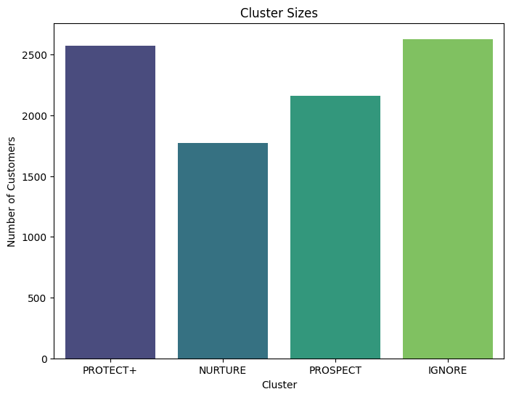
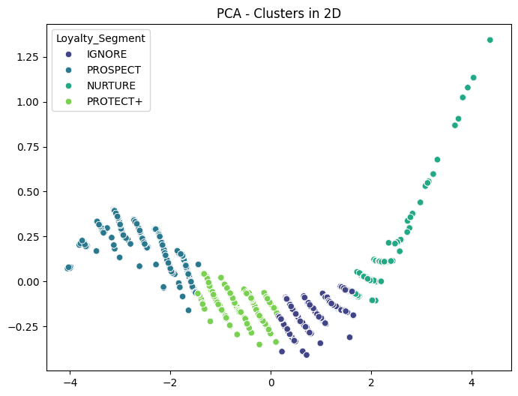
Analyzing Cluster Sizes and Characteristics
The bar chart displays the number of growers in each cluster segment.
Among all, IGNORE and PROTECT+ clusters have the largest share of growers, while NURTURE and PROSPECT are relatively smaller groups.
This distribution provides a quick overview of how growers are spread across segments, helping identify which groups dominate the overall customer base.
The scatter plot illustrates the clusters in a 2D space using PCA transformation, simplifying multidimensional data into clear patterns.
Each color represents a distinct cluster, showing clear separation among grower groups based on total sales, product count, and engagement level.
This visualization helps interpret cluster behavior differences, supporting deeper analysis and targeted strategy formulation for each segment.

Slide 17
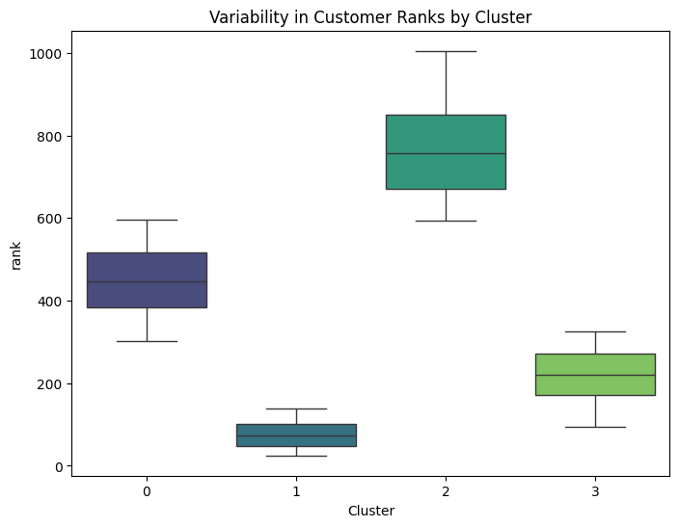
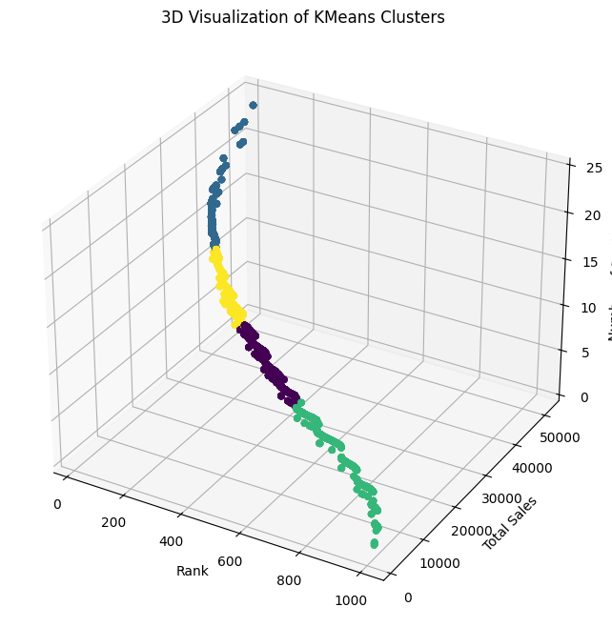
Variability in Customer Ranks by Cluster-Write
Boxplot Details:
Clusters Protect+ and Prospect show minimal spread, indicating low variability in customer ranks and consistent performance within these groups.
Cluster Nurture shows the largest spread in ranks, suggesting higher variability and mixed engagement levels among customers.
Cluster Ignore exhibits moderate variability, with a few high-rank outliers indicating inconsistent behavior within the group.
Cluster Protect+ includes some higher-rank outliers, showing a few top-performing customers standing out from the main cluster distribution.

Slide 18
Marketing Strategies by Segment:
PROTECT+
NURTURE
PROSPECT
IGNORE
Strategy: Personalized loyalty programs, exclusive content, referral incentives, and upselling/cross-selling.
Rationale: Reward and engage loyal customers, encouraging further advocacy and continued engagement.
Strategy: Targeted email campaigns, loyalty programs, customer surveys, and educational content.
Rationale: Increase customer loyalty by offering personalized rewards and enhancing brand engagement.
Strategy: Introductory offers, free trials, educational content, and retargeting ads.
Rationale: Convert potential into loyalty through compelling offers and educational touchpoints.
Strategy: Re-engagement campaigns, deep discounts, customer satisfaction surveys, incentivized reviews.
Rationale: Reactivate dormant customers and understand their needs to improve retention.

Slide 19
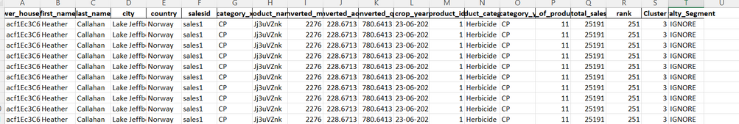
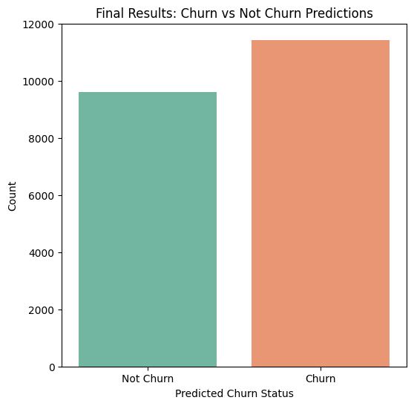
Random Forest for Customer Churn Prediction
Objective
Perform customer churn analysis to identify factors driving customer attrition and retention.
Leverage model-driven insights to pinpoint at-risk customers and improve overall customer loyalty.
Why Random Forest?
Effectively manages large, multi-dimensional customer data from multiple segments.
Provides feature importance scores, revealing key predictors such as total_sales, rank, and number_of_products that influence churn.
Generates predicted churn probabilities, allowing businesses to classify customers as likely to churn (1) or stay (0).
Enables data-driven segmentation for precise targeting of vulnerable customer groups.
Strategic Benefits
Improved Retention: Early detection of at-risk customers supports proactive engagement.
Actionable Insights: Empowers marketing and sales teams to design focused retention campaigns.
Resource Optimization: Allocates efforts toward customers with the highest churn risk.
Informed Decisions: Supports strategic planning using churn probability analytics.
0 for no churn, 1 for churned customers

Slide 20
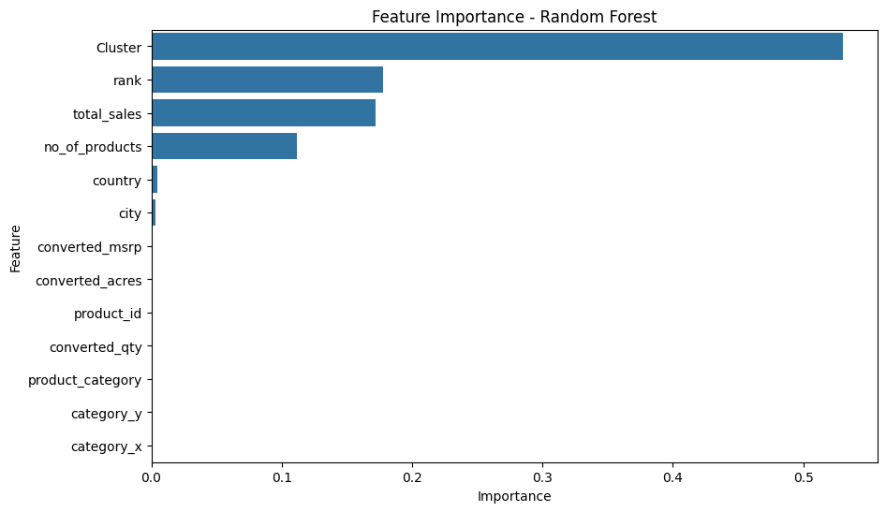
Feature Importance Analysis
Key Metrics
MeanDecreaseAccuracy: Indicates the drop in model accuracy if a feature is removed — higher values show stronger influence on prediction performance.
MeanDecreaseGini: Represents how effectively a feature separates churn vs. non-churn cases — higher values denote better split quality in decision trees.
Top Influential Features
1. Cluster
MeanDecreaseAccuracy: 0.54
MeanDecreaseGini: 0.49
Interpretation: The most critical variable for predicting churn. Cluster group membership strongly determines churn likelihood, showing that customer segments behave distinctly.
2. . Rank
MeanDecreaseAccuracy: 0.31
MeanDecreaseGini: 0.29
Interpretation: Rank has high predictive importance, suggesting that higher-ranked customers are more stable and less prone to churn.
3. Total Sales
MeanDecreaseAccuracy: 0.22
MeanDecreaseGini: 0.21
Interpretation: Total sales significantly impact churn prediction, indicating that customers with higher spending are more likely to remain loyal.
4. Number of Products
MeanDecreaseAccuracy: 0.12
MeanDecreaseGini: 0.11
Interpretation: Moderate influence — customers purchasing a wider range of products show stronger retention tendencies.

Slide 21
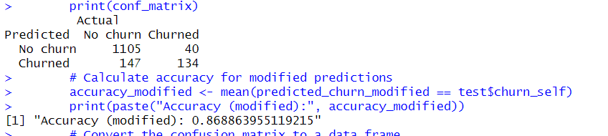
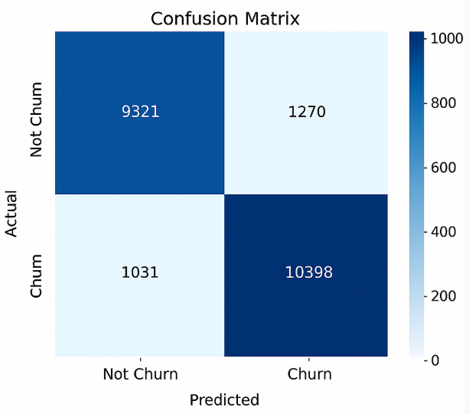
Continued...
The Random Forest model achieved an accuracy of 86.8%, meaning it correctly predicted the churn status for nearly 9 out of 10 customers.
This indicates strong predictive performance and reliable classification of churn vs. non-churn customers.
The four sections show different types of predictions:
True Positives (TP): 10,398 – Customers correctly predicted as churned who actually churned.
False Positives (FP): 1,270 – Customers incorrectly predicted as churned but actually retained (Type I error).
False Negatives (FN): 1,031 – Customers incorrectly predicted as not churned when they actually churned (Type II error).
True Negatives (TN): 9,321 – Customers correctly predicted as not churned and actually retained.

Slide 22
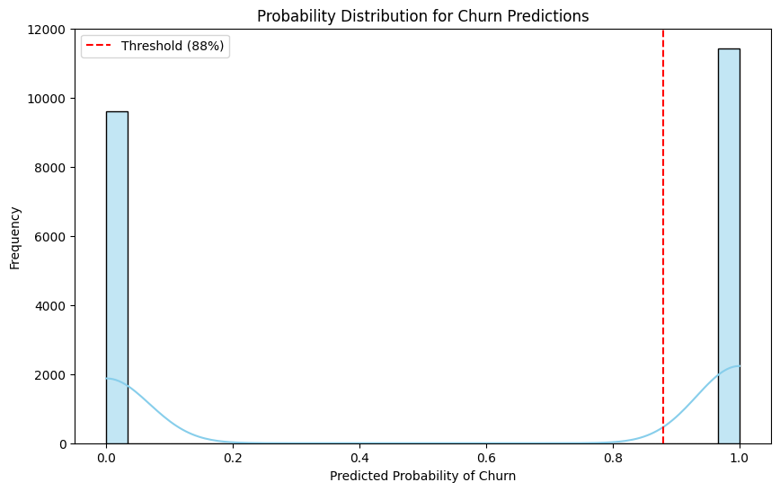
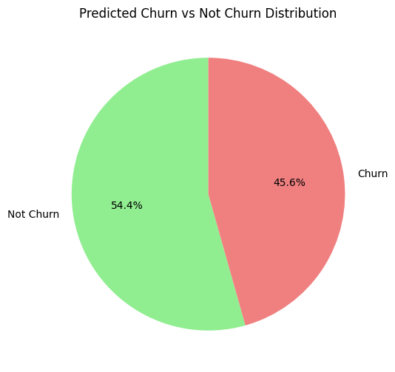
Random Forest Model - Churn Prediction and Confidence
Shows the distribution of predicted churn probabilities from the Random Forest model.
X-Axis: Represents predicted probability of churn (ranging from 0 to 1).
Y-Axis: Represents the frequency of predictions within eachprobability range.
Clustering: Strong clustering near 0 and 1 indicates high confidence in predictions.
Threshold (0.6): Red dashed line marks the decision boundary between “Churn” and “Not Churn.”
Prediction Classification:
Probabilities above 0.6 are classified as "Churn."
Probabilities below 0.6 are classified as "Not Churn."
Model Strength: The clear separation of the two classes shows the model’s ability to make confident, distinct predictions.
The pie chart summarizes the classification results. Out of all predictions, 45.6% of customers are predicted to churn, while 54.4% are expected to stay.
This balanced distribution indicates that the model is capturing both churners and non-churners effectively, ensuring better targeting strategies for retention efforts. The relatively even split also suggests a well-calibrated model suitable for operational decision-making.

Slide 23
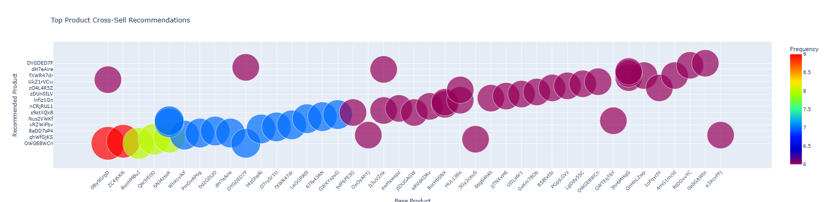
Corteva Cross-Sell Insights – Seeds, CP, Speciality
Leverage Market Basket Analysis to identify cross-sell opportunities across Corteva’s three key categories — Seeds, Crop Protection (CP), and Specialty Products.
Purpose:
Increase product penetration per grower
Strengthen loyalty and retention
Enable data-driven, region-specific sales strategies
Model used - Apriori Algorithm (Market Basket Model)
Group transactions by City–Country–Grower combinations.
Identify frequent itemsets (product co-purchases).
Generate association rules with metrics.
Strong Cross-Sell Opportunities
Base products on the left (e.g., 8gn9oPp, ZxK9e6) have bright red/yellow bubbles, meaning they pair strongly with recommended products like DYGD6DT, dhFzare.
These should be prioritized for bundling or targeted offers.
Moderate Associations
Middle section (e.g., QW8e4d, WhWkVc) shows blue bubbles, indicating decent co-purchase frequency.
Good candidates for personalized recommendations.
Sparse High-Frequency Pairs
On the far right, bubbles are mostly purple, meaning weaker associations.
These can be used for secondary recommendations, not primary bundles.

Slide 24
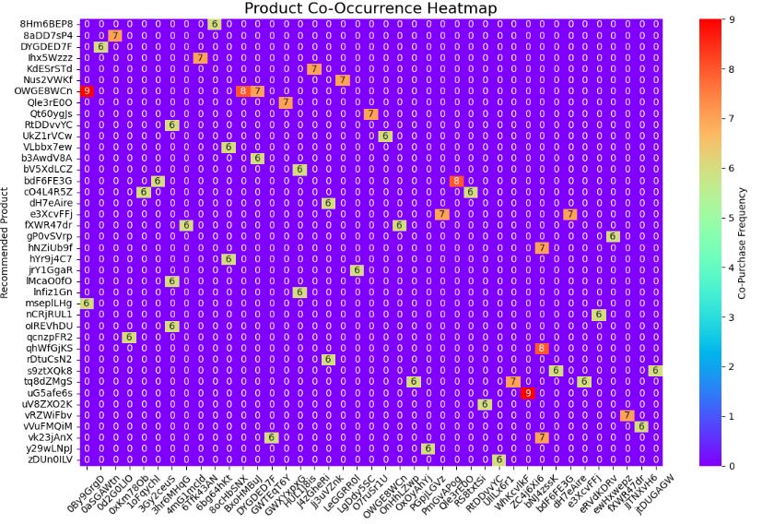
Product Co-Occurrence Heatmap (Seaborn)
Most cells are 0, meaning many products are rarely bought together.
Hotspots (yellow/red cells) indicate strong associations:
Example: NJSZWKX with 8hmB6EPB (value = 7)
Another strong pair: tg62M6gs with WZrWM6w (value = 9).
Cells with values ≥ 5 (yellow/red zones) indicate products that customers often buy together.

Slide 25

Strategic Recommendations for Reducing Customer Churn
Enhance Multi-Product Adoption
Encourage customers to purchase from multiple Corteva product categories (Seeds, Crop Protection, Specialities).
Design bundled offers and cross-sell campaigns — multi-product customers show significantly lower churn probability.
Strengthen Engagement for Mid-Rank Customers
Focus field visits, agronomy support, and loyalty incentives on mid-tier customers with medium sales.
Introduce personalized crop advisory, seasonal product recommendations, and relationship-building calls.
Loyalty and Value Programs
Implement tiered loyalty rewards based on repeat purchase, sales volume, and product diversity.
Offer early-booking discounts and referral benefits to reinforce stickiness.
Measure and Sustain Impact
Track churn reduction, repeat purchase rate, and cross-sell uplift as key KPIs.
Run quarterly pilots to validate which interventions deliver the highest retention ROI.

Slide 26


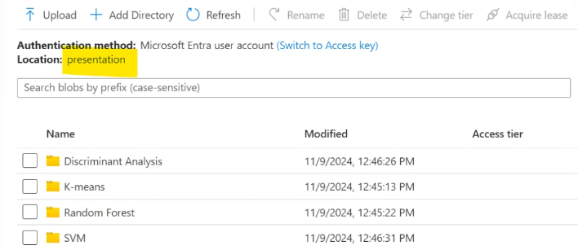
PowerBI Demo

Slide 27
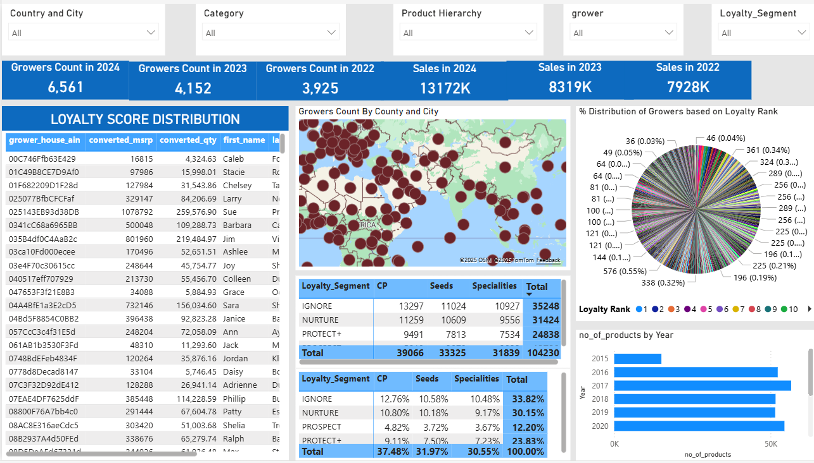
Loyalty Score and Grower Distribution Analysis (2016-2025)

Slide 28
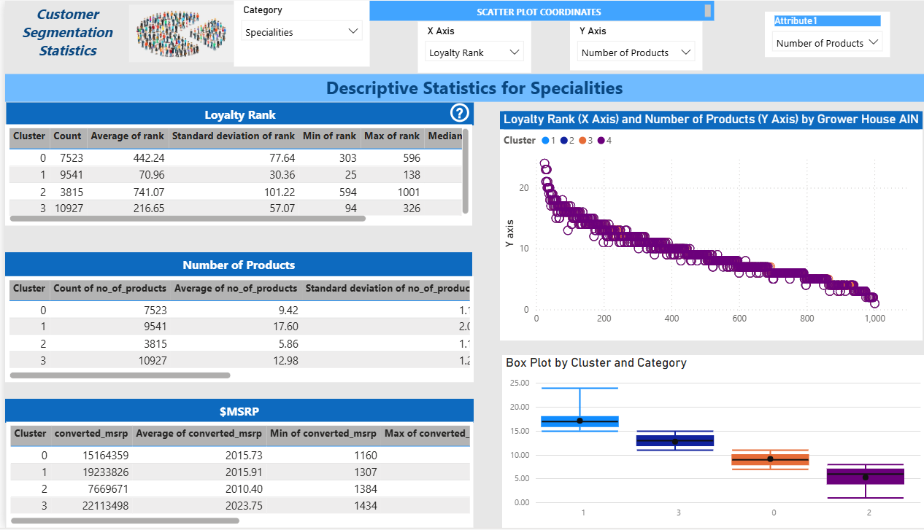
Cluster-Based Descriptive Analysis for Customer Loyalty and Products

Slide 29
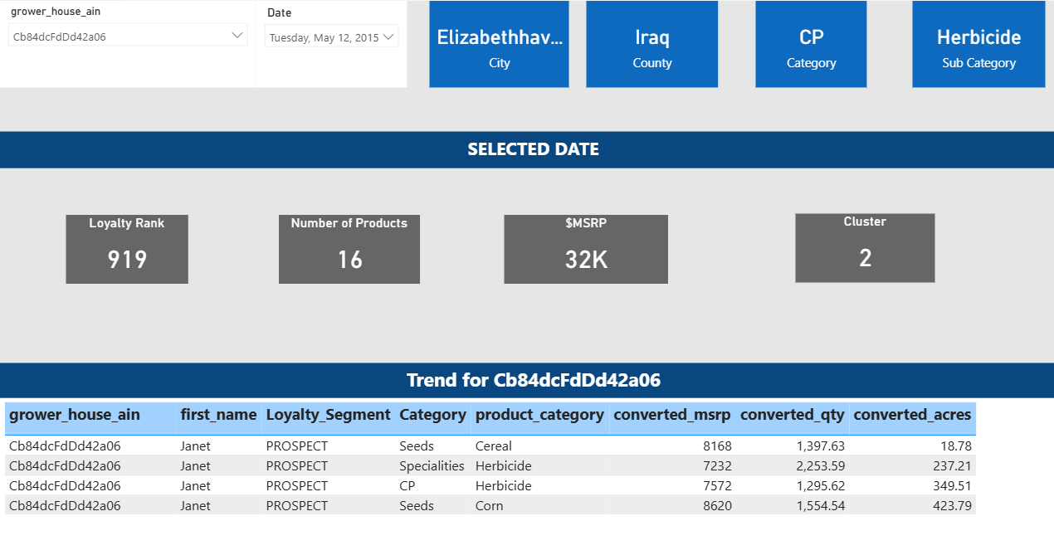
Grower insight and product performance overview

Slide 30
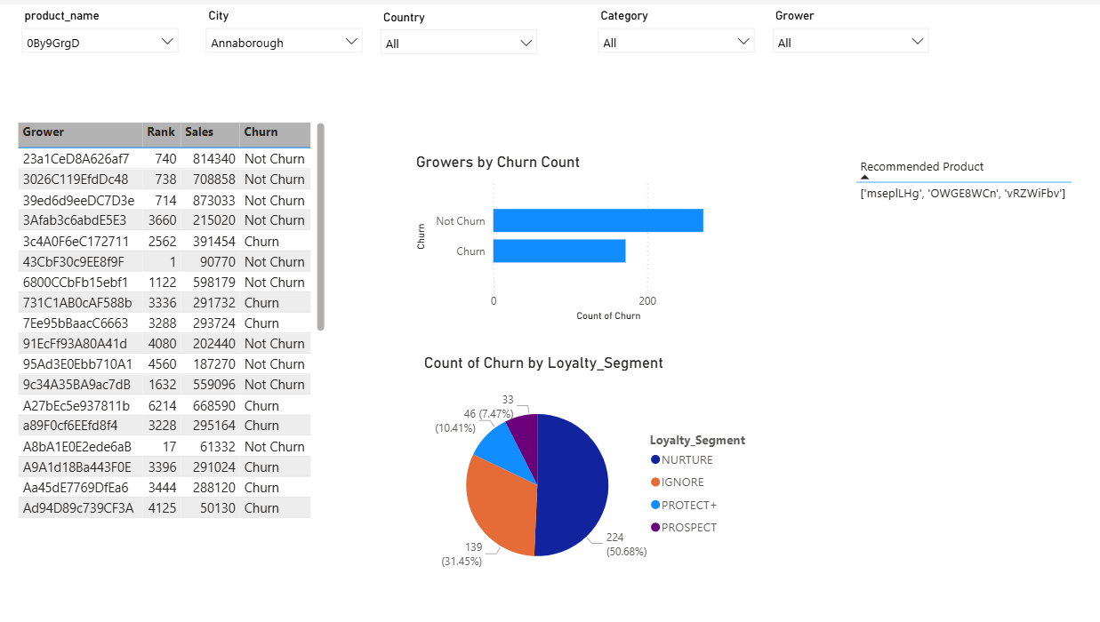
Cross Sell Recommendation

Slide 31
THANK YOU

